Slide 1


AI Impact on Jobs
Presented by:
Mazen Ahmed
Aya Reda
Youssef Amr
Anas Sayed
Omar Mohamed

Slide 2


Problem Definition:
The integration of Artificial Intelligence (AI) into various sectors is transforming job roles, work environments, and employment trends across industries. This scientific report aims to investigate the impact of AI on employment by analyzing a dataset of 30,000 job records that includes information such as job titles, industry classification, AI impact levels, salary data, remote work ratios, educational requirements, automation risk, and more.

Slide 3

The core problems addressed in this analysis are:
01
Relationship between AI Impact Level and Industry
Experience vs. Projected Job Openings
04
Remote Work Opportunities vs. AI Impact
02
05
03
Impact of Location, Education, and Remote Work on Automation Risk
Median Salary Differences Across Industries

Slide 4

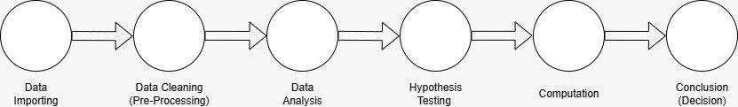
Methodologies used:
Chi-Square test | Used to test independence between two categorical variables.
One-Way ANOVA | Used to compare the means of two groups(Categorical vs Numerical).
T-test | Used to compare the means of two groups(Binary categorical vs Numerical).
Simple Linear Regression | Used to check the linear relationship between two variables(one dependent and the other is independent).
Multiple Linear Regression | Used to check the linear relationship between more than two variables(one independent and several dependent variables, including numerical and encoded categorical data ).
Flowchart

Slide 5

Data Description
Column | Description
Job Title | The title or role of the job position.
Industry | The industry sector to which the job belongs (e.g., IT, Finance, Healthcare).
Job Status | Indicates whether the job market for this role is growing, shrinking, or stable.
AI Impact Level | Categorical variable indicating the degree to which AI impacts this job: Low, Moderate, or High.
Median Salary (USD) | Annual median salary for the job role, expressed in US dollars.
Required Education | The minimum educational qualification needed for the role (e.g., Bachelor's, Master's).
Experience Required (Years) | Number of years of professional experience required.
Job Openings (2024) | The number of open positions projected for the year 2024.
Projected Openings (2030) | The number of open positions projected for the year 2030.
Remote Work Ratio (%) | Percentage of work that can be done remotely for the job role.
Automation Risk (%) | Estimated percentage likelihood that the job could be automated.
Location | Country or region where the job is primarily based.
Gender Diversity (%) | Proportion of female representation in the job or industry.
The dataset used in this study comprises 30,000 job entries across multiple industries and geographical regions. It contains detailed information on various attributes relevant to job roles, including salary, education, experience, AI impact level, and automation risk. The dataset serves as a comprehensive snapshot of the current and projected employment landscape in the context of AI integration.

Slide 6
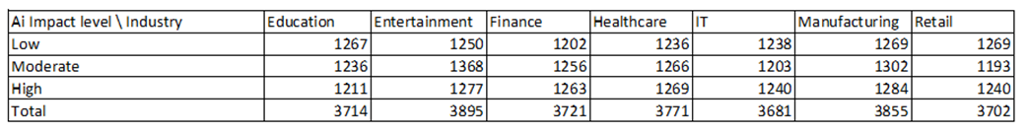
Question 1:
Is there a relationship between AI Impact Level and Industry?
Objective: To determine if the level of AI impact on a job is dependent on the industry.
Methodology: Chi-Square Test for Independence.
Hypotheses:
H0​: AI Impact Level is independent of Industry.
H1​: AI Impact Level is associated with Industry.
Data Preparation: Filtered data to remove null values in 'AI Impact Level' or 'Industry'.
Contingency table created to summarize observations.
Expected frequencies calculated.

Slide 7
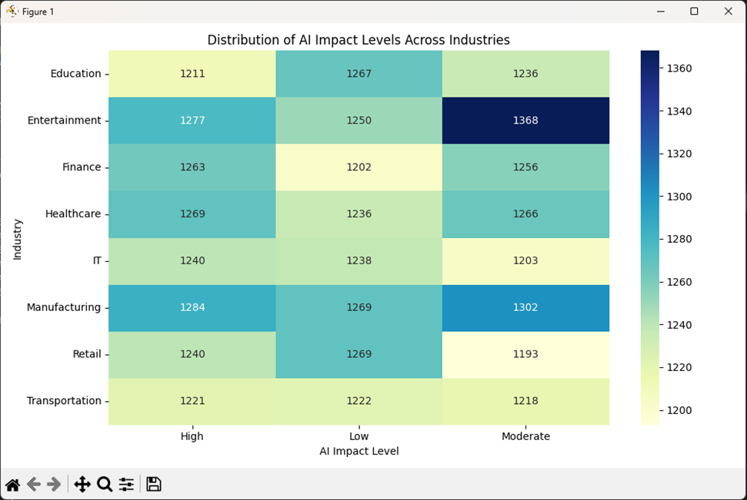
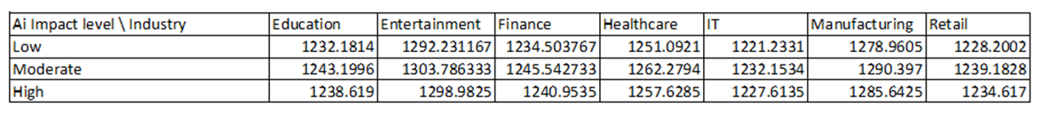
Heat map:
Expected table:

Slide 8
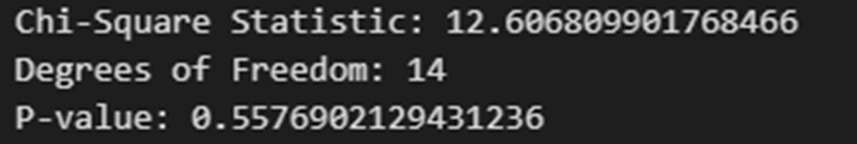
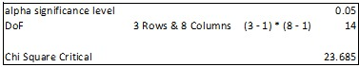
Results and Conclusion:
Chi-Square Statistic (X2 test): 12.6068
Degrees of Freedom (df): 14
P-value: 0.5576
Significance Level (α): 0.05
Chi-Square Critical (X2 critical): 23.685
Comparison:
X2 test (12.6068) < X2 critical (23.685)
P-value (0.5576) > α (0.05)
Conclusion:
We fail to reject the Null Hypothesis (H0​).
There is no statistically significant relationship between AI Impact Level and Industry in this dataset.
Observed differences are likely due to chance.

Slide 9
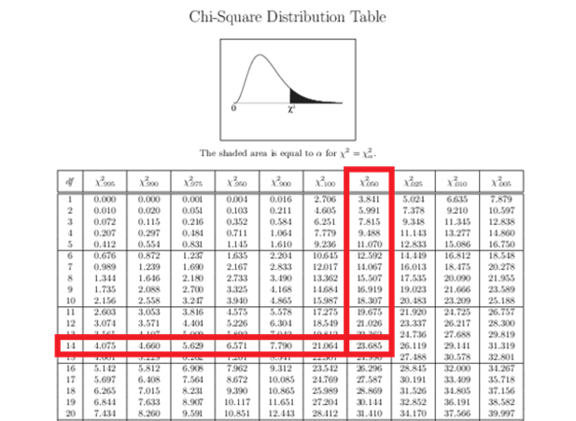
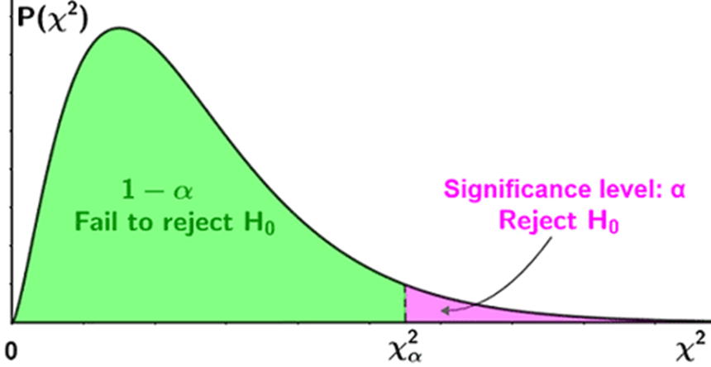

Slide 10
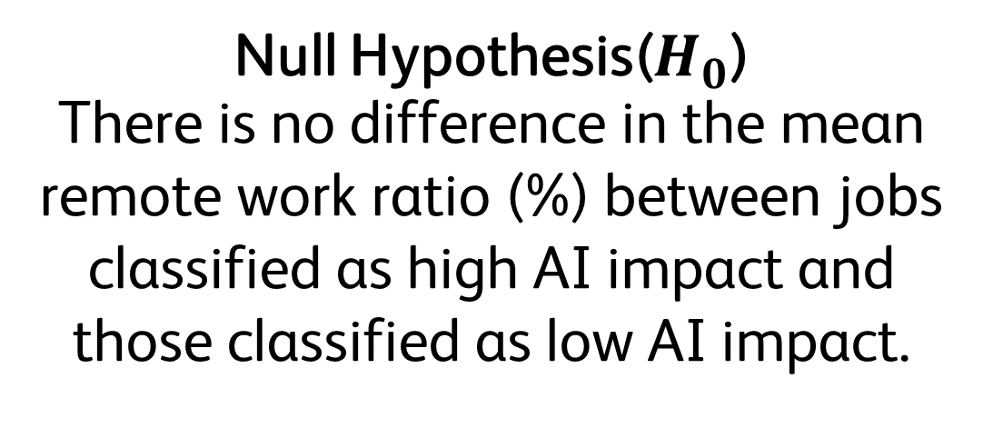
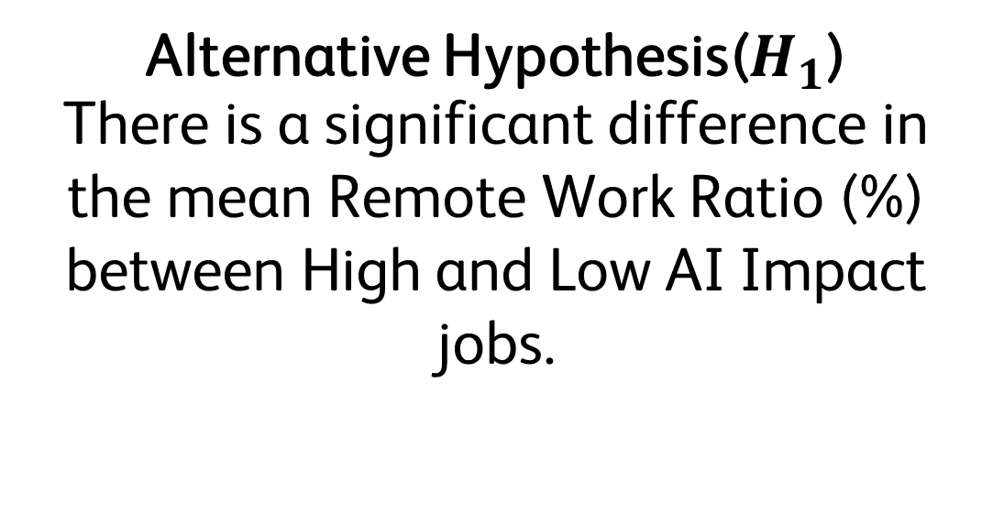
Question 2
Do jobs with a High AI Impact Level have a significantly different Remote Work Ratio (%) compared to jobs with a Low AI Impact Level?
Steps:
Filter the Data + Observation
Group Definition
Compute the results
Compare the results
Conclusion (Decision)
Methodology: T Test for Independence
An independent samples t-test was used. This test compares the mean of 2 independent groups while not assuming equal variances.
Null Hypothesis($H_{0}$)
There is no difference in the mean remote work ratio (%) between jobs classified as high AI impact and those classified as low AI impact.
Alternative Hypothesis($H_{1}$)
There is a significant difference in the mean Remote Work Ratio (%) between High and Low AI Impact jobs.

Slide 11
Steps
Defining the groups:
● Group 1: Jobs with High AI Impact Level
● Group 2: Jobs with Low AI Impact Level
Sample Sizes:
● High Impact Jobs: 10005
● Low Impact Jobs: 9953
Descriptive Statistics:
Group Mean Remote Work Ratio (%) Std Dev
High AI Impact 74.1% ~5.3
Low AI Impact 52.5% ~3.9
Conclusion:
Since the p-value is significantly less than 0.05, we reject the null hypothesis. There is a statistically significant difference in Remote Work Ratios between High and Low AI Impact jobs.

Slide 12
Question 3:
Is there a significant difference in median salary across different industries?
Objective: To evaluate if there are statistically significant differences in median salaries across various industries.
Methodology: One-Way Analysis of Variance (ANOVA).
Hypotheses:
H0​: All industries have the same mean salary.
H1​: At least one industry has a significantly different mean salary.
Significance Level (α): 0.05

Slide 13
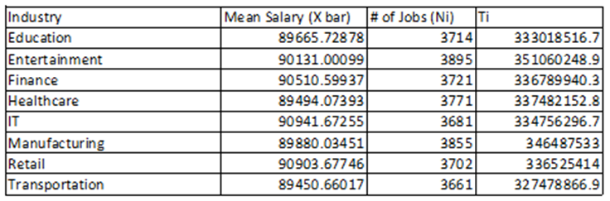
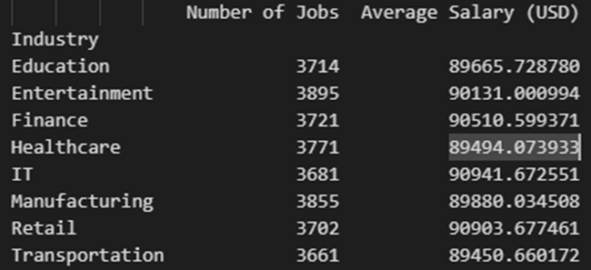

Slide 14
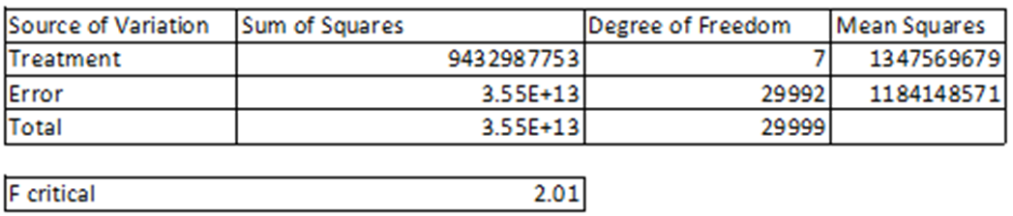
Results and Conclusion:
ANOVA Results:
Degrees of Freedom (Between groups, df1​): 7
Degrees of Freedom (Within groups, df2​): 29,992
F-statistic (F0​): 1.14
P-value: 0.3356
Critical Value (F0.05​(7,29992)): ≈2.01
Comparison: F0​ (1.14) < Critical Value (2.01)
P-value (0.3356) > α (0.05)
Conclusion: We fail to reject the Null Hypothesis (H0​).
There is no statistically significant difference in mean median salaries across the 8 industries.
Any observed differences are likely due to chance.

Slide 15
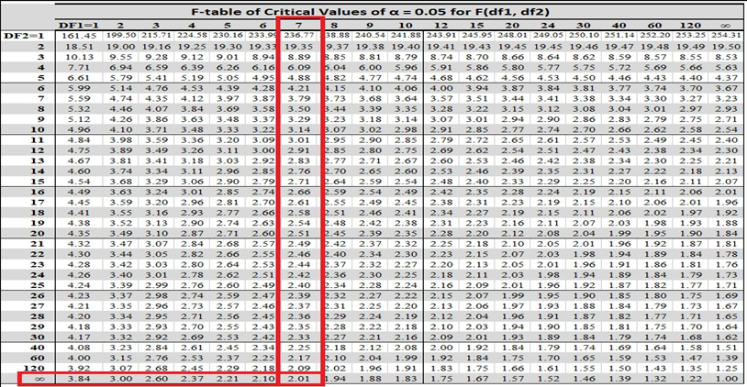
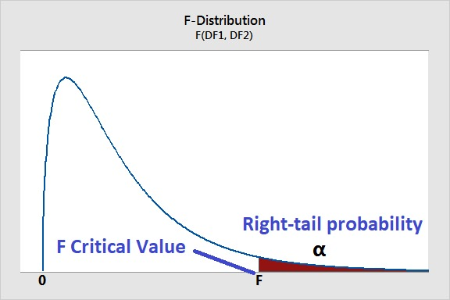

Slide 16
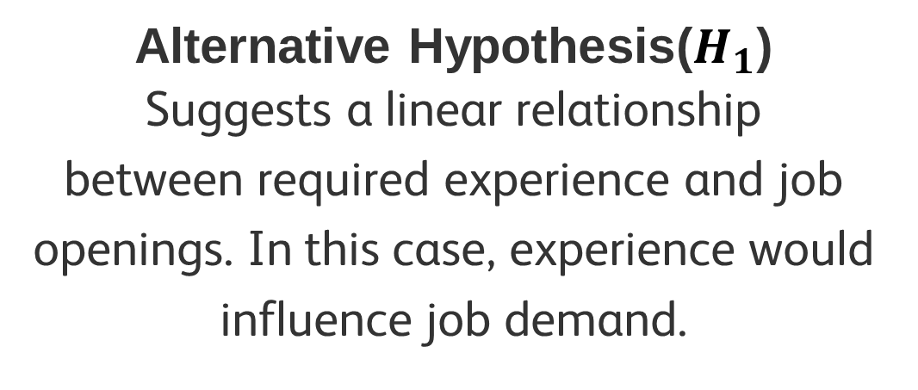
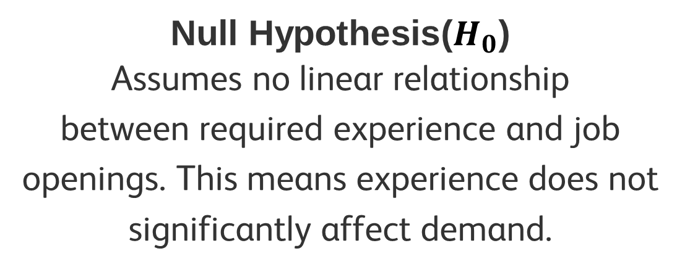
Question 4
Is there a linear relationship between required experience and job openings?
Methodology: Simple Linear Regression
Dependent Variable: Job Openings(2024)
Independent Variables: Experience Required (years)
The correlation was extremely weak (r = -0.0013), with an R² value near zero.
No significant linear relationship exists and other factors influence job demand.
Null Hypothesis($H_{0}$)
Assumes no linear relationship
between required experience and job openings. This means experience does not significantly affect demand.
Alternative Hypothesis($H_{1}$)
Suggests a linear relationship
between required experience and job openings. In this case, experience would influence job demand.

Slide 17
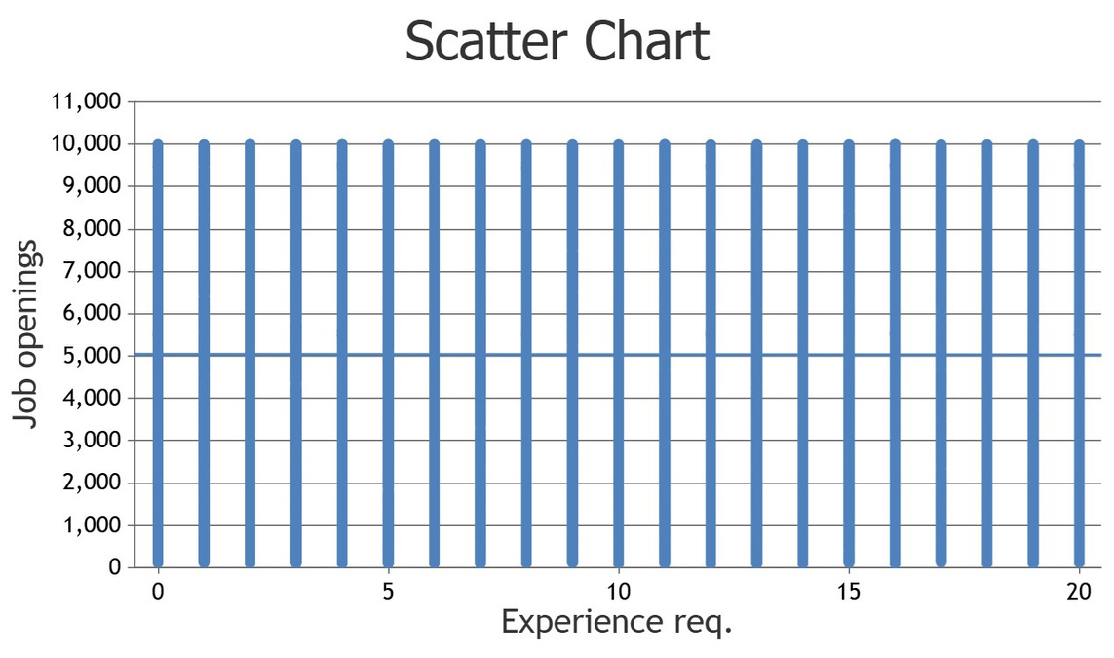
Scatter Plot
The scatter plot shows no clear trend.
Simple linear regression confirms no relationship between Job openings and Experience required, so
experience required does not significantly impact job openings.

Slide 18
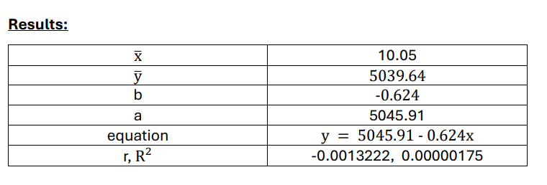
Results
The slope is nearly zero and negative, indicating a very weak inverse relationship between experience and job openings. R² is extremely low, meaning less than 0.0002% of the variation in job openings is explained by experience.

Slide 19
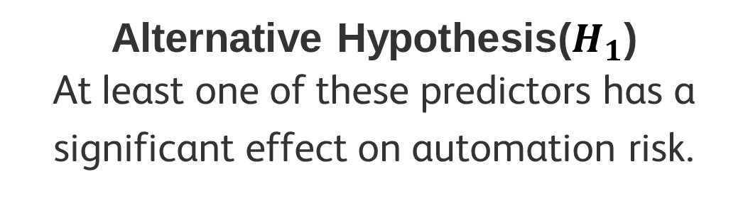
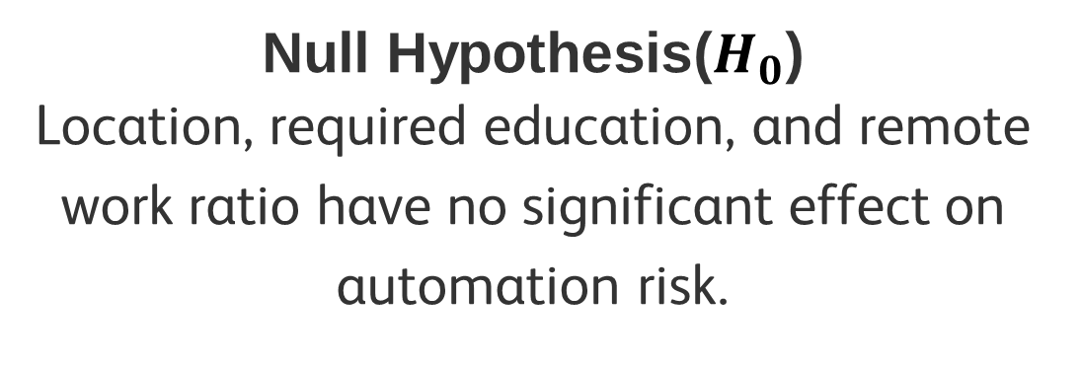
Question 5
How do location, education, and remote work affect automation risk?
Methodology: Multiple Linear Regression
Dependent Variable: Automation Risk(%)
Independent Variables:
Remote Work Ratio (%)
Location
Education
Location and education are non numeric variables so you converted them to dummy variables 1 for presence and 0 for absence
Null Hypothesis($H_{0}$)
Location, required education, and remote work ratio have no significant effect on automation risk.
Alternative Hypothesis($H_{1}$)
At least one of these predictors has a significant effect on automation risk.

Slide 20
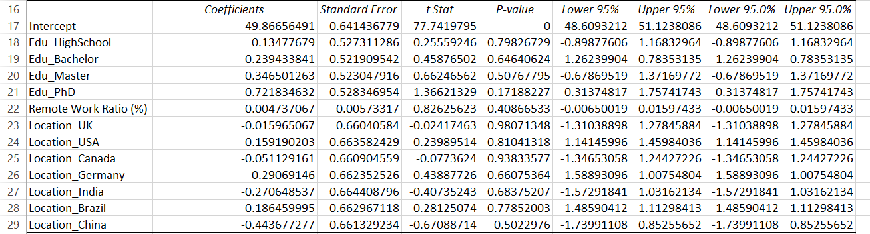
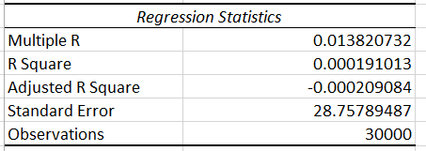
Results

Slide 21
Model Statistics
R² = 0.000 → Model explains almost none of the variation. {Poor fit} Adjusted R² = -0.000 F-statistic p-value = 0.929 → Model not significant.
Interpretation
None of the predictors have a statistically significant effect (all p-values > 0.05). Remote Work Ratio (%) has a tiny positive coefficient (+0.0047), meaning a 1% increase in remote work changes automation risk by 0.0047%, which is negligible. Differences between locations and education levels are also minimal and not significant.

Slide 22
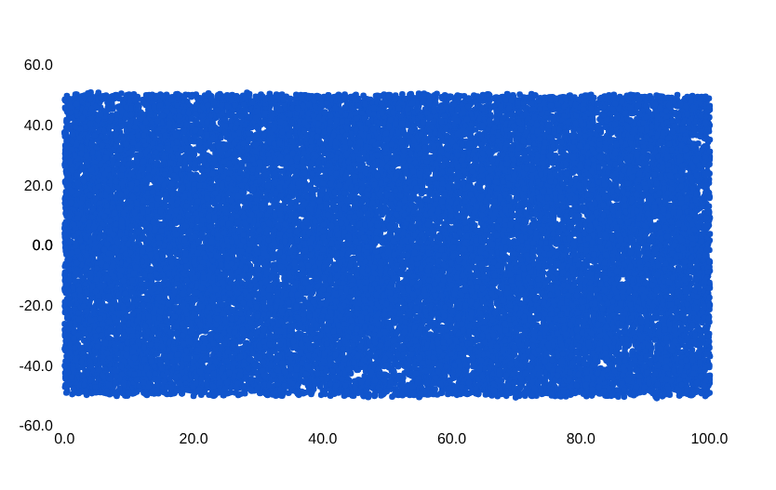
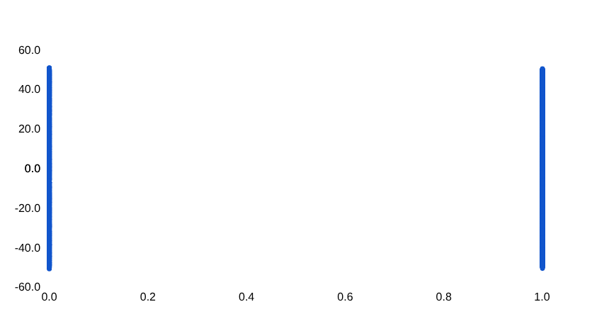
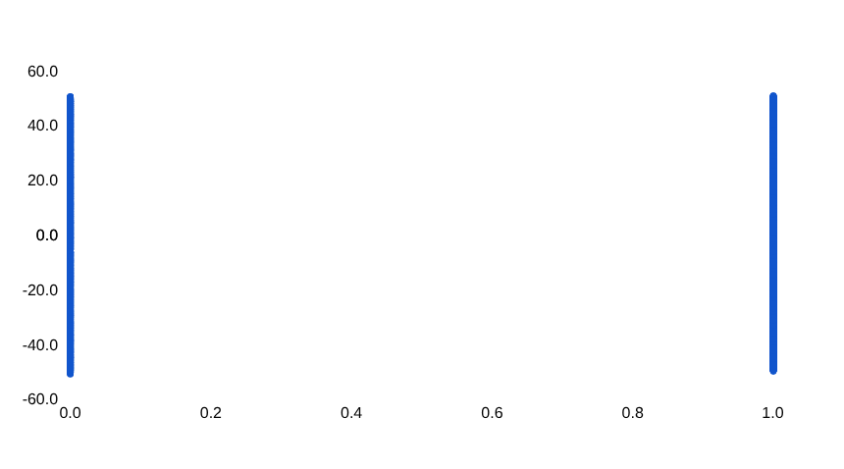
Plots

Slide 23
Conclusion
The multiple linear regression analysis shows that Location, Required Education, and Remote Work Ratio (%) do not significantly predict Automation Risk, so we failed to reject the null hypothesis. The model’s explanatory power is negligible (R² = 0.000) and no predictor had a p-value < 0.05. Other variables not included in this model likely have a stronger influence on automation risk.

Slide 24

Thanks!

